Slide 1
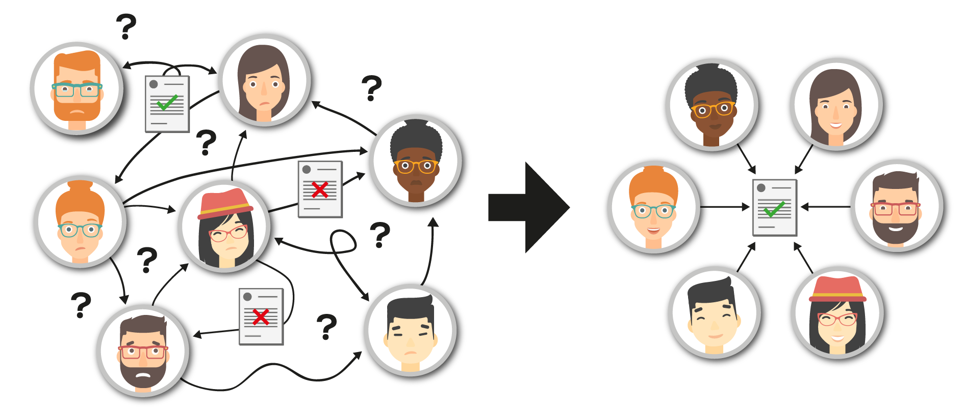
Instant Relief for Accounts Payable
Notes:
slide 1 should be only the highlight one sentence

Slide 2
> 1 Million Organizations
> 22 Billion Invoices

Slide 3
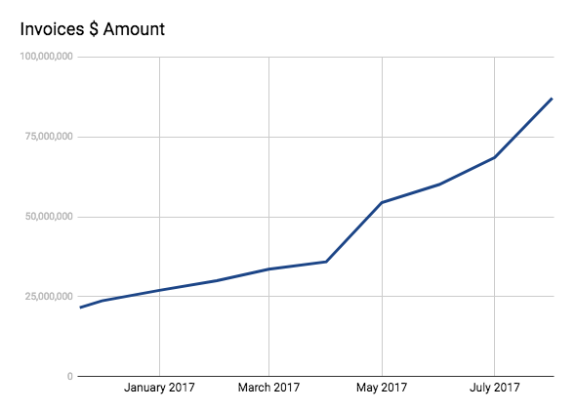
8/2016 Raised $2.4M From Bloomberg beta and Hillsven
> 50 Customers
> $1B annual invoices managed in Stampli (show over time)
> 4,500 Registered Users
> 1,100 active users
> 70 activities/day per customer
> 131,400 Vendors, active> 10,000
Avg invoice > $5,000
15% compound monthly growth in all parameters

Slide 4
Eyal Feldman, Co-Founder, CEO
An entrepreneur with 15 years of leadership experience in the business software market.
So much learned as Stampli CEO
Global management of enterprise solutions sales delivery and support (SAP,EMC- Documentum, FICO and more)
Advisory board member for EMC (IIG)
Experience in business strategy, product & sales, and leadership
Ofer Feldman, Co-Founder , VP R&D
An R&D leader with 15 years of experience in leading ISVs
SW Development Group manager at McKesson
VP of R&D at Social Fabrics startup
SAP Labs SW Dev Leader
Co inventor in 7 Patents at SAP Lab
4 Employees in the US (Marketing, Sales, Success)
4 Employees in Israel (Development)

Slide 5
The (AP) Problem
Thousands of invoices on a journey to be verified and processed
Each invoice is a task with multiple touch points
Huge efforts to verify and follow-up with stakeholders
Things get lost during the “journey”
Things processed (and paid!) twice
A “black hole” full of undesired surprises
Lengthy preparations for Audits
High operations and management costs
Notes:
לשנות בולטים לבעיה ולא לנושא לדוגמא : עלויות גבוהות

Slide 6
Our Vision
Turn each invoice into an integrated frontend landing page allowing all stakeholders to collaborate and enjoy value added services.
Notes:
unify iim with platform

Slide 7
Product Demo
Click to watch video
Notes:
Only one slide that sends us to the demo

Slide 8
Value Added Services
Reverse Factoring
Foreign Exchange Opportunity
Payment Solution
Tax Calculation
And More...

Slide 9
Sept – Present Growth Parameter
Year - Month | Invoices | $ Amount
2017 - 07 | 10,971 | 71,212,336
2017 - 06 | 9,951 | 59,665,932
2017 - 05 | 8,239 | 54,432,638
2017 - 04 | 7,073 | 35,863,945
2017 - 03 | 6,610 | 33,621,131
2017 - 02 | 6,011 | 30,180,650
2017 - 01 | 5,335 | 26,935,268
2016 - 12 | 4,534 | 23,658,106
2016 - 11 | 4,162 | 21,498,200
2016 - 10 | 2,941 | 17,565,180
Today (estimates, will update later)
Number of customers: 50
Number of Invoices: 250K
Amount managed: >$1B
Number of active Users: >1500
Number of active Suppliers: >10K
Average number of daily actions per customer: >50
ARR: $250k
Indirectl CAC: $1600
Channels CAC:
LTV: 26,000
Notes:
leave place for 2 graphs here

Slide 10
Industrial
Consumer Electronics
Retail
Services
Oil, Gas
Hospital and Healthcare
Oil
Electronic Components
Services
Transportation Services
Electrical Components
Media
Leisure and Hospitality
Insurance
Construction
Apparrel
Debt Collection
Real Estate
Renewables

Slide 11
Goto Market
Main Channels:
Google Ads
ERP Trade Shows/Partners
Direct calls/emails
Organic & Vendors Virality
Sales:
Inside Sales
Partners:

Slide 12
Competitive Landscape
Time to Implement
1 Hour
3 Months
6 Months
TCO
250K
50K
5K
Notes:
look for anothe x (not cost)

Slide 13
Plan
Raising $5.4M for 18 Months, will get us to $4.4M ARR
Click here for detailed budget

Slide 14
For more information:
www.stampli.com

