Slide 1
Bridging the gap between Clinical Engineering and IT
Shankar Somasundaram
shankar@asimily.com | 650-224-9653

Slide 2
Asimily Mission
MEDICAL DEVICE LIFECYCLE MANAGEMENT
Maximizing device uptimes and value derived from medical device

Slide 3
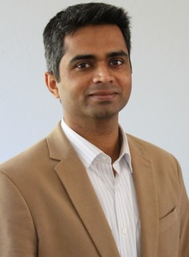
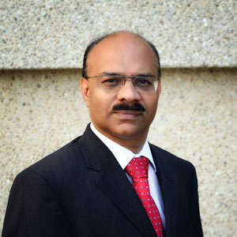
Asimily Team
Our Team has Experience around Healthcare, Security and Networking
Shankar Somasundaram
CEO
Sr. Director, Internet of Things Symantec
Ran Healthcare business and other connected device business
CEO of a remote healthcare startup in India
Hithesh Nama
CTO
Director, Spider Cloud Wireless
Research and Development for Spider Cloud Wireless around networking and machine learning
ASIMILY CORE ADVISORY TEAM
Axel Wirth
Distinguished Architect, SYMC
Steve Grimes
Ran clinical for a couple of healthcare networks
Mike Brown
Ex-CEO, Symantec
Amit Jasuja
Ex-SVP, Symantec, Oracle
Sriram Bharadwaj
CISO, UC Irvine Healthcare

Slide 4
Unique Challenges in Healthcare
Unsupported legacy devices
Large variety of devices vendors and device types
Large variety of devices vendors and device types
Unique protocols, data sources, regulations
Metadata widely distributed
Non-medical medical devices
Providers have to deal with…
Limited Device Visibility
Too many devices to patch
IT security tools not built for medical devices
Leads to Operational Inefficiency

Slide 5
Need to know criticality of devices to improve operational efficiency
Likelihood
HIGH
Important devices that need to be monitored closely
Critical devices that need highest focus
LOW
HIGH
Low risk devices that can be looked at periodically
Important devices that need to be monitored closely
LOW
Impact : Patient, Data, Business

Slide 6
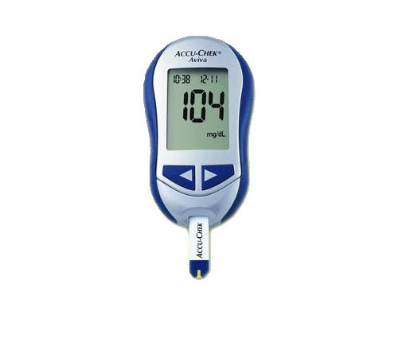
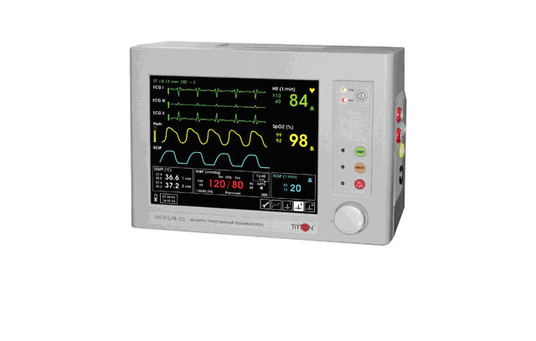
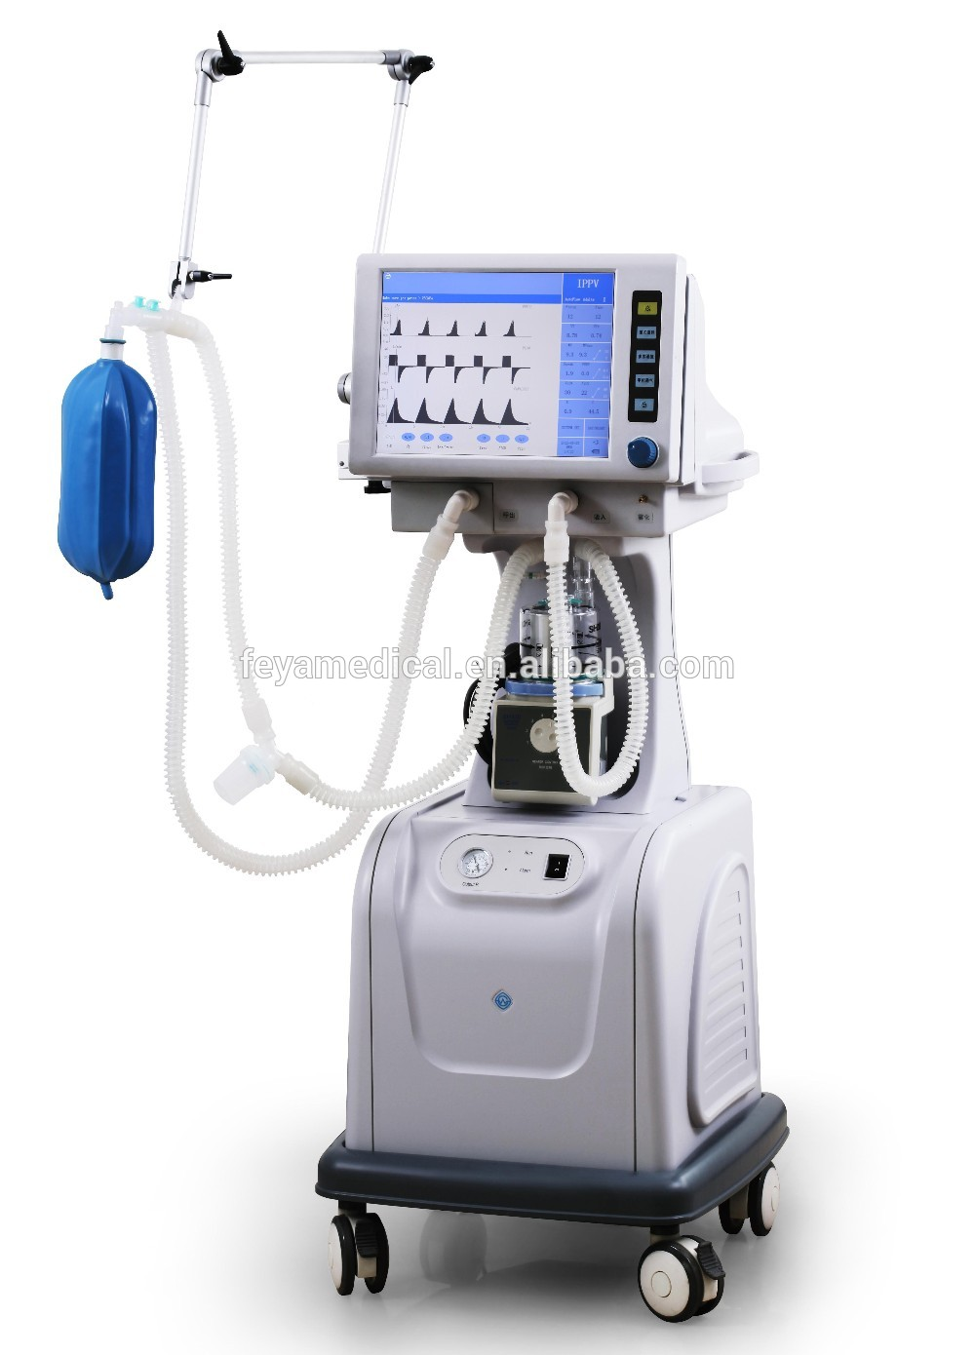
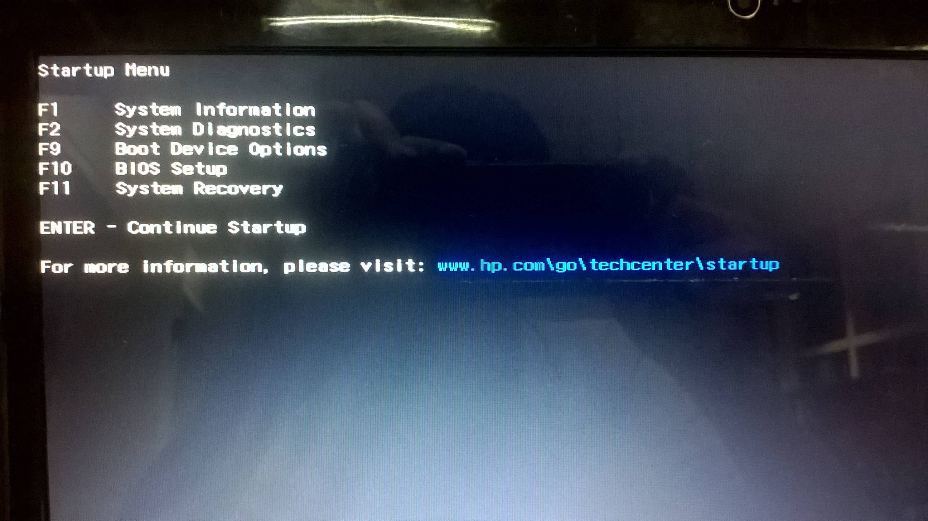
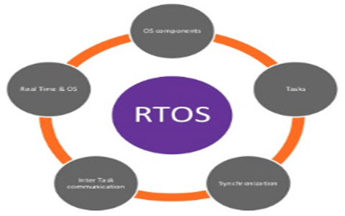
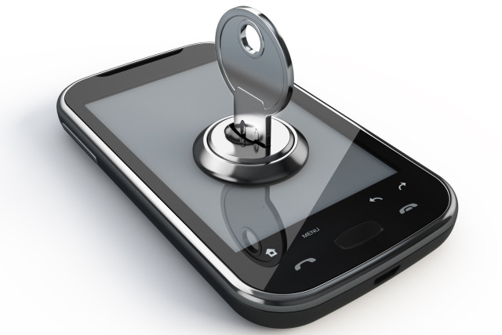
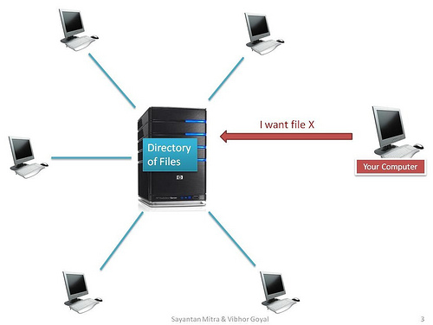
Likelihood and impact varies across…
DEVICE TYPE
Blood Glucose Monitor
Vital Signs Monitor
Ventilator
Risk
OS TYPE
No OS
RTOS
Windows
Risk
CONFIGURATION
Hardened device
Network file share
Internet browsing
Risk

Slide 7
Multi-dimension approach needed
MEDICAL (& NON-MEDICAL) DEVICE MASTER DATA RECORD
DEVICE RELATIONSHIPS
IT parameters
Medical device parameters
Cyber-security parameters
Network asset Utilization
Device Inter-relationships
Data flow
Ability to navigate network
CONTEXUAL RISK
Prioritized List of Devices and Alternatives to Patching
PATCH AND MITIGATION PRIORITIZATION
RISK MONITORING, REMEDIATION AND PREVENTION
Vulnerabilities
Configuration
Vulnerability Exploit Vectors
Impact to Patient care, Data Privacy and Operations
Device baselines and device profiles
Security anomalies
Operational anomalies
Segmentation of devices based on device context
Blocking or quarantine at network

Slide 8
Example: Spectre does not pose a high risk to all devices and there are ways to mitigate
Spectre vulnerability is at the chip level and so affects every software available
Even though vulnerability is widespread, research shows that it is hard to attack with software running on system except through a java script running on the browser
So while strong access controls are recommended, only devices with affected versions of browsers have a real risk to spectre *Asimily has validated these aspects
Patching can be complex and can slow down the system
So patches are being avoided or not being released by manufacturers
Fortunately options are available to mitigate the main source of attack
Stop browsing on all affected devices OR
Browse only using browser versions which have workarounds to prevent any attack OR
Configure browsers (disable shared array buffer) to reduce the risk of attack
Asimily has validated all options above
Asimily identifies devices with a real risk to spectre and provides options to mitigate
ASIMILY HAS RESEARCHED EVERY WINDOWS AND MANY LINUX VULNERABILITIES LIKE THE ABOVE TO FIND ATTACK VECTORS AND WORKAROUNDS

Slide 9
The Right Approach
DO YOU STILL NEED TO PATCH EVERY LEGACY WINDOWS XP DEVICE?
We have seen that only ~10% of the devices which are detected as having high priority vulnerabilities by scanners are really at high risk
More than 50% of high risk devices are the workstations and servers connected to the medical devices
Get used as general purpose hardware creating entry points into the network and which can be patched
Further Asimily provides options to fix the device without a patch for vulnerabilities where possible
The right approach needs to account for uniqueness of medical devices to help providers reduce patching costs

Slide 10
Asimily INSIGHT- Bring IT and Medical Device Worlds Together
ONLINE DATA SOURCES
MANUFACTURER
NVD
ICS CERT
FDA RECALL
FDA CLASSIFICATION
MEDICAL (& NON-MEDICAL) DEVICE MASTER RECORD
DEVICE RELATIONSHIPS
PATCH AND MITIGATION PRIROITIZATION
RISK MONITORING, REMEDIATION AND PREVENTION
PROVIDER
COMMUNITY + ASIMILY
CMMS (if required)
MDS2
PROVIDER
ASIMILY RESEARCH
OTHER SOURCES LIKE SCANNERS
PROVIDER NETWORK
NETWORK META-DATA + HEALTHCARE PROTOCOLS

Slide 11
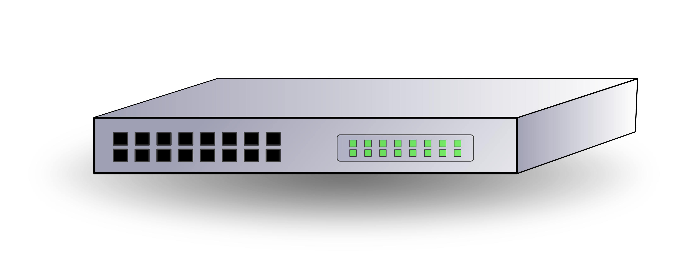
INSIGHT Deployment Architecture
CLOUD (Runs on-line crawlers and has Asimily research)
TLS, port 5432
TLS, port 5432
OPTIONAL
INTERNET
DATA ANONYMIZATION
Provider HEALTH FIREWALL
Provider HEALTH NETWORK
Provider Console for UI
Backup Server
OPTIONAL
SIEM
Provider CMMS
Vulnerability scanners
Provider MDS2 repository
Information from Edge Processor.
Sending messages back to Cisco ISE and Firewall
Information from Edge Processor.
Sending messages back to Cisco ISE and Firewall
Asimily On-premise Data Aggregator Software on Provider Managed Servers
Provider Network Subnet
Span port
Span port
Provider Network Subnet
Information from edge to server
Information from edge to server
Provider existing Gateway/router (could be core switch)
Provider existing Gateway/router (could be core switch)
Asimily Edge Packet Processor
Asimily Edge Packet Processor
Provider Medical Device Network
Provider Medical Device Network
Note: Edge processors can directly feed information to Asimily Cloud which would remove the need for Provider Data center

Slide 12
Patch and Mitigation prioritization and Focus on Healthcare key differentiators
CUSTOMER NEEDS | Network based players (e.g. Zingbox, CloudPost, etc) | ASIMILY INSIGHT
Complete medical device master view | ✓ | (Also extract from MDS2 to get security capabilities)
Device Relationships | (Partial) ✓ | (Navigable) ✓
Patch and Mitigation Prioritization | ✗ | ✓
Risk Monitoring, Remediation and Prevention of Incidents | ✓ | ✓
Detailed Asset utilization | ✓ | ✓
Lifecycle management | ✗ | (2019) ✓
Cyber-compliance and Mfg. sharing interface. | ✗ | (2019) ✓

Slide 13
Bridging the gap between Clinical Engineering and IT
Shankar Somasundaram
shankar@asimily.com | 650-224-9653

