Slide 1
Telehealth in Today's Senior Living World

Slide 2
THURSDAY APRIL 16, 2020 AT 2:00 PM EST
Town Hall Virtual Event for Senior Living
TeleHealth in Today's Senior Living World
GOAL: Showcasing both Successes and Lessons Learned During Dramatic Changes in TeleHealth
A Town Hall meeting for sharing experiences with telehealth.
What is changing?
What have you tried that is unique and want to share?
Work Survey
Hosted by Constant Companion LLC, a voice- and video-technology provider to the senior care community

Slide 3
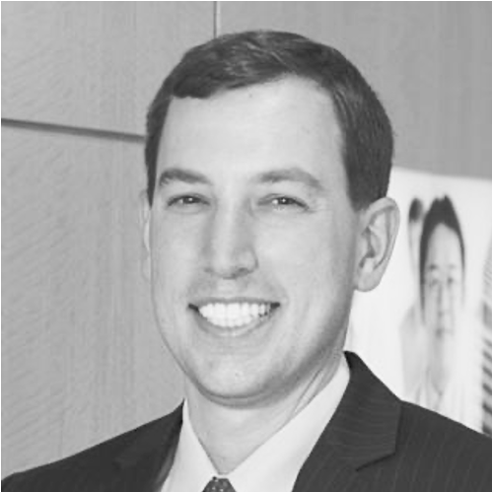
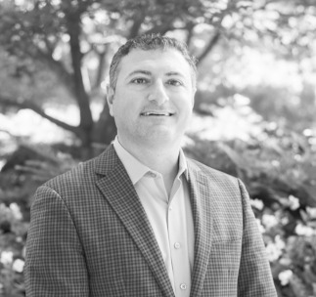
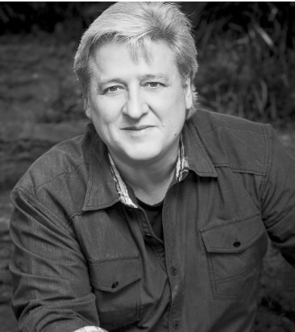
MODERATOR: Paul Valcheff
DR. JESSE EHRENFELD
America Medical Association
BAHA ZEIDAN
Azalea Health
JENNIFER GUILMETTE
SOC Telemed
PETER ROSENBERGER
Hope for the Caregiver
PANELISTS

Slide 4
PANELIST
“How can you laugh through what you all live through!?”
Peter Rosenberger often hears that question when people learn of his 34+ year journey as a caregiver for his wife, Gracie, who lives with severe disabilities (80 operations & the amputation of both legs).Yet, Peter and Gracie draw hope from their deep faith which strengthens their hearts—and the couple brings a contagious inspiration that lightens weary hearts struggling with challenges.
Peter’s weekly radio show, Hope for the Caregiver, is heard on more than 180 stations, and on Sirius XM’s Family Talk Channel (131).Through his show, books, commentaries, and speaking events, Peter addresses life’s caregiving challenges with candor, compassion, and even comedy.
Educating, entertaining, and empowering audiences across the country, Peter offers poignant insights into the life of a caregiver. Weaving his deep compassion for fellow caregivers with his outrageous humor, Peter assuringly points others to safety and helps them develop plans to live a calmer, healthier, and even more joyful life as caregivers.
PETER ROSENBERGER
Hope for the Caregiver

Slide 5
PANELIST
Jesse M. Ehrenfeld, MD, MPH, is the Joseph A. Johnson Jr. Distinguished Leadership Professor at the Vanderbilt University School of Medicine in the departments of anesthesiology, surgery, biomedical informatics, and health policy. Elected to the American Medical Association Board of Trustees in 2014, currently serves as Chair.
Dr. Ehrenfeld divides his time among clinical practice, teaching and research. Serves as director of education research for the Vanderbilt Office of Health Sciences Education, director of the Vanderbilt Program for LGBTQ Health, and associate director of the Vanderbilt Anesthesiology & Perioperative Informatics Research Division. Appointed as an adjunct professor of surgery at the Uniformed Services University of the Health Sciences in Bethesda, Md., served as special advisor to the 20th U.S. Surgeon General.
Dr. Ehrenfeld’s research, which focuses on understanding how information technology can improve surgical safety and patient outcomes, has been funded by the National Institutes of Health, the Department of Defense, the Robert Wood Johnson Foundation, the Anesthesia Patient Safety Foundation, and the Foundation for Anesthesia Education and Research. Written 250 abstracts, published 195 peer-reviewed manuscripts. Editor-in-chief of the Journal of Medical Systems. Co-authored 15 clinical textbooks that have been translated into multiple languages.
Born in Wilmington, Del., Dr. Ehrenfeld is a graduate of Phillips Academy, Haverford College, the University of Chicago Pritzker School of Medicine and the Harvard School of Public Health. Internship in internal medicine, a residency in anesthesiology and a research informatics fellowship at the Massachusetts General Hospital.
DR. JESSE ERHENBERGER
Chair, Board of Trustees
American Medical Association

Slide 6
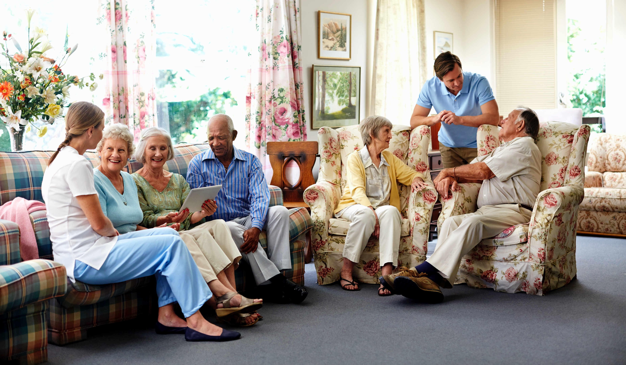
PANELIST
Baha is the Co-founder and CEO of Azalea Health, a leading healthcare IT company whose mission it is to help underserved healthcare providers improve patient care and profitability. Under Baha’s leadership, Azalea has established itself as a high-growth innovator and leader, developing a comprehensive, cloud-based health IT platform for ambulatory practices and hospitals -- including introducing the industry’s first fully-integrated proprietary telehealth solution with its EHR. Achieved Inc. 5000 rank of fastest-growing companies in the U.S for three consecutive years. A Top 40 Innovative Technology Company by The Technology Association of Georgia. Received Phoenix Award by the Metro Atlanta Chamber Bioscience-Health IT Leadership. A 2018 recipient of the Atlanta Business Chronicle’s 40 Under Forty Award. A 2019 recipient of their Most Admired CEOs Award. President of the Technology Executives Roundtable. Active member of the Atlanta Rotary Club. Serves on the Kennesaw State University Healthcare Management & Informatics Advisory Board.
BAHA ZEIDAN
CEO
Azalea Health
Atlanta, GA
first EHR company to successfully incorporate proprietary telehealth functionality into its solution

Slide 7
PANELIST
Jennifer is passionate about delivering outstanding customer service, driving healthcare transformation, and providing access to quality care for every patient. Leading the enterprise project management office and client implementation team, Jennifer drives SOC’s vision of connecting patients to the highest quality clinicians at the right time—regardless of proximity.
A certified Project Management Professional (PMP®) and a Lean Six Sigma Green Belt, Jennifer focuses on improving clinical care, patient outcomes, and organizational health. Based in Nashville, Jennifer applies her talents as a creative, dynamic, results-oriented leader and operations efficiency specialist. At SOC, she has guided hundreds of successful implementations. SOC, the largest provider of telemedicine solutions to hospitals and health systems nationwide, uses their innovative technology platform, Telemed IQ, to deliver patient care virtually, both in hospitals and in post-acute settings including Skilled Nursing Facilities.
JENNIFER GUILMETTE
VP - Project Management & Implementations
SOC Telemed
Reston, VA
leader in acute care telemedicine

Slide 8
Thank you for attending!
www.ConstantCompanion.com

