Slide 1
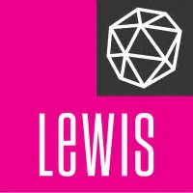
Building a Health IT Practice at

Slide 2
The Opportunity for Lewis in Health IT
IN THE FIRST HALF OF 2017, VC INVESTMENT IN DIGITAL HEALTH EQUALED…
188 DEALS
$3.5 BILLION
82% OF TOTAL INVESTED IN 2016
Growth in funding outpaced other areas of healthcare, such as medical devices.
LEWIS has an outstanding opportunity to make inroads into the untapped Health IT sector
Highly relevant core strengths in Integrated Communications, Research & Analytics, Content, Digital Marketing
Outstanding experience in Tech (relevant expertise in Security, BI/Analytics, Cloud Computing)
Hot areas:
consumer health engagement, population health management,
big data analytics tied to value-based reimbursement.

Slide 3
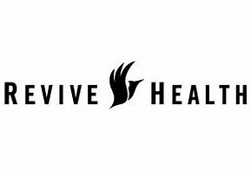
Competitive Landscape
BOUTIQUE
BOUTIQUE
BOUTIQUE

Slide 4
Health IT Client’s Communications Needs
Start-ups: SWOT Analysis; Messaging Workshop: Definition of value proposition, elevator pitch, key differentiators, competitive positioning; Deck for VCs, industry analysts and media audiences; Media Coaching; Integrated Communications Planning and Execution; Influencer & Industry Analyst Relations; Speaking Engagements & Awards; Contributed Content; Lead-Gen activities; Digital and Social strategy.
More mature companies: Corporate Communications; Paid/Earned/Shared/Owned (PESO) Media; Digital and Social; Marketing: SEO, Omnichannel Content Strategy & Execution; Crisis Communications; Public Affairs; Corporate Social Responsibility; Investor Relations.

Slide 5
STEPS TO BUILDING A HEALTH IT PRACTICE
Build Culture for Sustained Success
Campaigns: VC Roadshow; KOL partnerships
Develop content/speaking calendar
Develop networking/prospecting strategy
Gain agency-wide buy-in
Create prospect lists & client acquisition strategy
Define offering, including POV, ROI-driven case studies
Assess capabilities, talent, experience

Slide 6
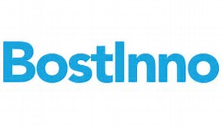
Tried & True Networking & Prospecting Venues
PRSA HEALTH ACADEMY
APRIL 25-27
WASHINGTON D.C.
HITMC ANNUAL CONFERENCE
APRIL 4-6
NEW ORLEANS

Slide 7
Campaign: VC Roadshow
Active companies:
Aktana, Binary Fountain, Carevive Systems, ClearDATA, mPulse Mobile, OnShift, Persivia, Phreesia, Welltok, Inc., AbleTo, Ampersand Health, Imagine Health, LinkWell Health, MedOptions, Nordic Consulting, Oceans Healthcare, RedBrick Health, Regroup Therapy, Sanovia Corporation, Teladoc
Active companies:
Aria CV, Inc., Augmenix, Inc., Pavillion Holdings Group, Kaleidoscope Medical, Lantos Technologies, Maxwell Health, nVision Medical, Pavilion Medical Innovations (PMI), Saphena Medical, Sera Prognostics, Inc., Seven Oaks Biosystems
Active companies:
Bright Health, Docent Health, Welltok, ClearCare, GetInsured.com, Health Essentials, Medi Assist, Remedinet
Active companies:
Blue Cloud, CareCloud, ClearDATA, Health Catalyst, iCardiac, iRhythm, NextHealth Technologies, Omada Health, Qventus, RiverMend Health, Science Exchange, Silk Road Medical, Talkspace, TigerText, VisitPay

Slide 8
Campaign: KOL Partnership
Noted health economist, “Health Populi” blogger and thought-leader Jane Sarasohn-Kahn covers the intersection of healthcare, technology, policy and people.
She has worked on branded thought leadership initiatives with multiple organizations, including IBM Watson Health, Castlight, PwC and many more.
Initiatives include CEO Q&As, speaking panels, state of the industry reports/surveys, blog post series, Webinars and more.
Recent topics of interest include “state of the industry” reporting, consumerism in healthcare, AI, wearables, telehealth, health policy, care coordination, analytics, security and privacy.

Slide 9
Building a Culture for Success
Incentives & rewards at all levels
Celebrate client renewals, leads that develop into clients
Recognize outstanding client work
Foster a fearless work culture
Everyone can contribute – the prospecting process is like casting a movie
Regular creative brainstorms (for clients and prospects)
Emphasize continual learning
Between Two Plastic Plants
(Influencer Q&As)
Regular workshops and outside trainings
Gartner Research briefings
Cultivate internal & external talent
Prospect via PRSA Health Academy, HIMSS New England Chapter Empower ownership of initiatives

Slide 10
30 DAYS
30-60-90 Day Program Snapshot
60 DAYS
90 DAYS
Complete capabilities, talent, experience analysis
Develop prospecting strategy/timeline/targets
Create core prospecting materials
Create training schedule
Evangelize strategy
agency-wide
Finalize VC roadshow and KOL campaigns
Prospect outreach begins
Internal trainings begin
Prospecting/Branding presence at major industry events
VC roadshow and KOL campaigns kick-off
New Business pitches
in full swing
Steady drumbeat of thought leadership and trainings

Slide 11
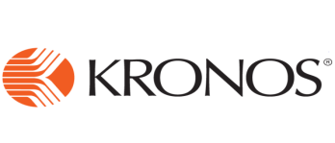
Other Regional Targets
Health IT Leaders Headquarter in the Boston Area

Slide 12
PREPARED EXCLUSIVELY FOR:
DOUGLAS RUSSELL
1.617.416.8181
Doug.r.russell@gmail.com

