Slide 1
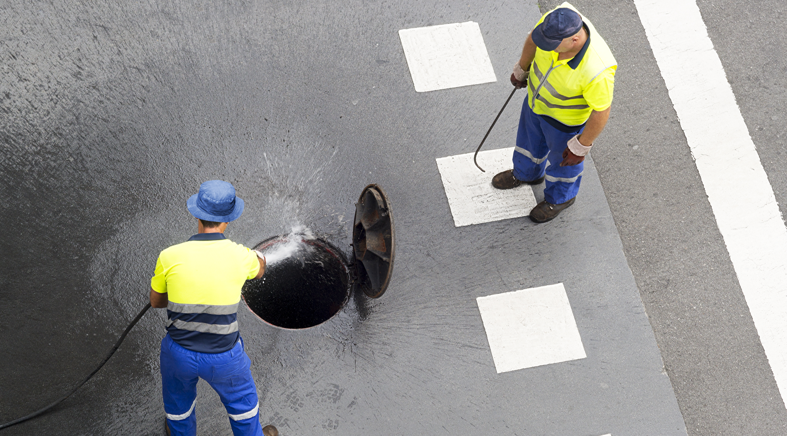
MADEWELL BRANDING

Slide 2
Branding Notes
Madewell has had the same logo for over 50 years. It has been requested that it to be refreshed to keep up with the current times and to better represent the company.
It was requested that we do designs for the Mainstay product line logo as well.
Colors requested were blue, orange, gray but was also left up to the designer to add any additional color palettes.
This main logo will also be incorporated into their Mainstay product line.
It was also requested that there be a standalone brandmark that could be used on packaging to show that the Mainstay products were a product of Madewell.
That the word “Madewell” would have the option of “MadeWell” since clients seem to misunderstand the word.

Slide 3
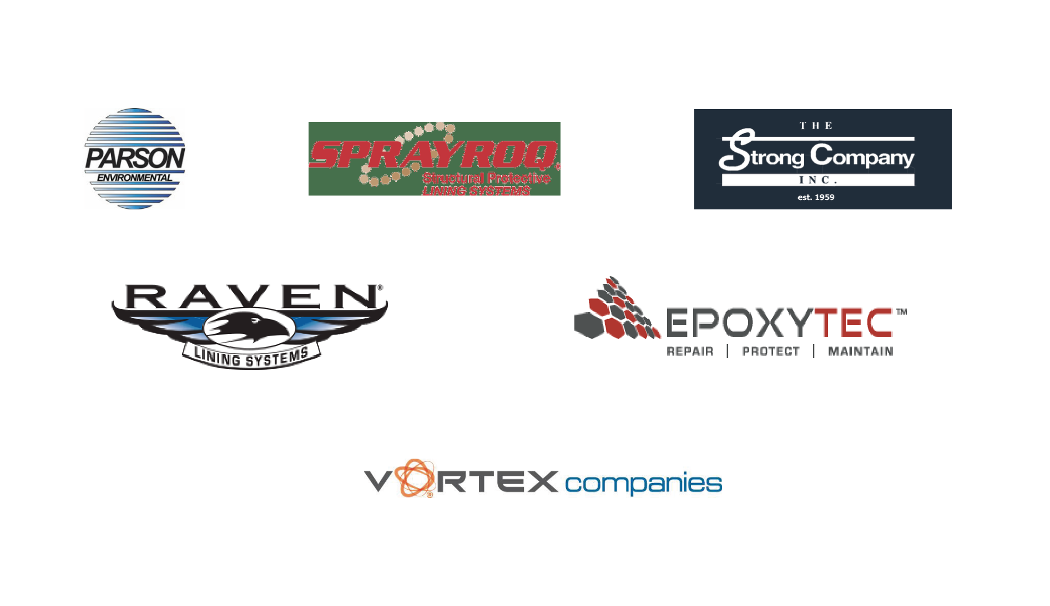
Competitors’ Logos

Slide 4
Current Logos

Slide 5
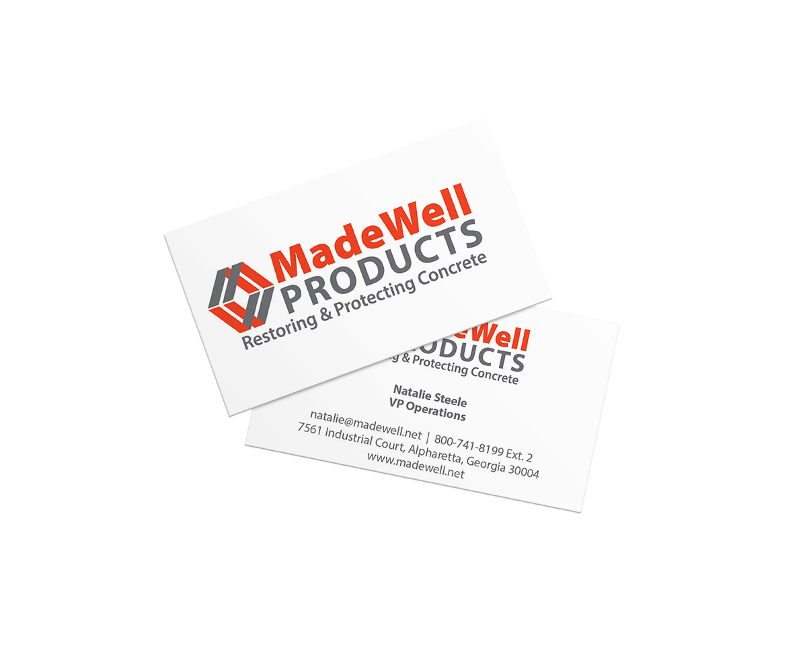

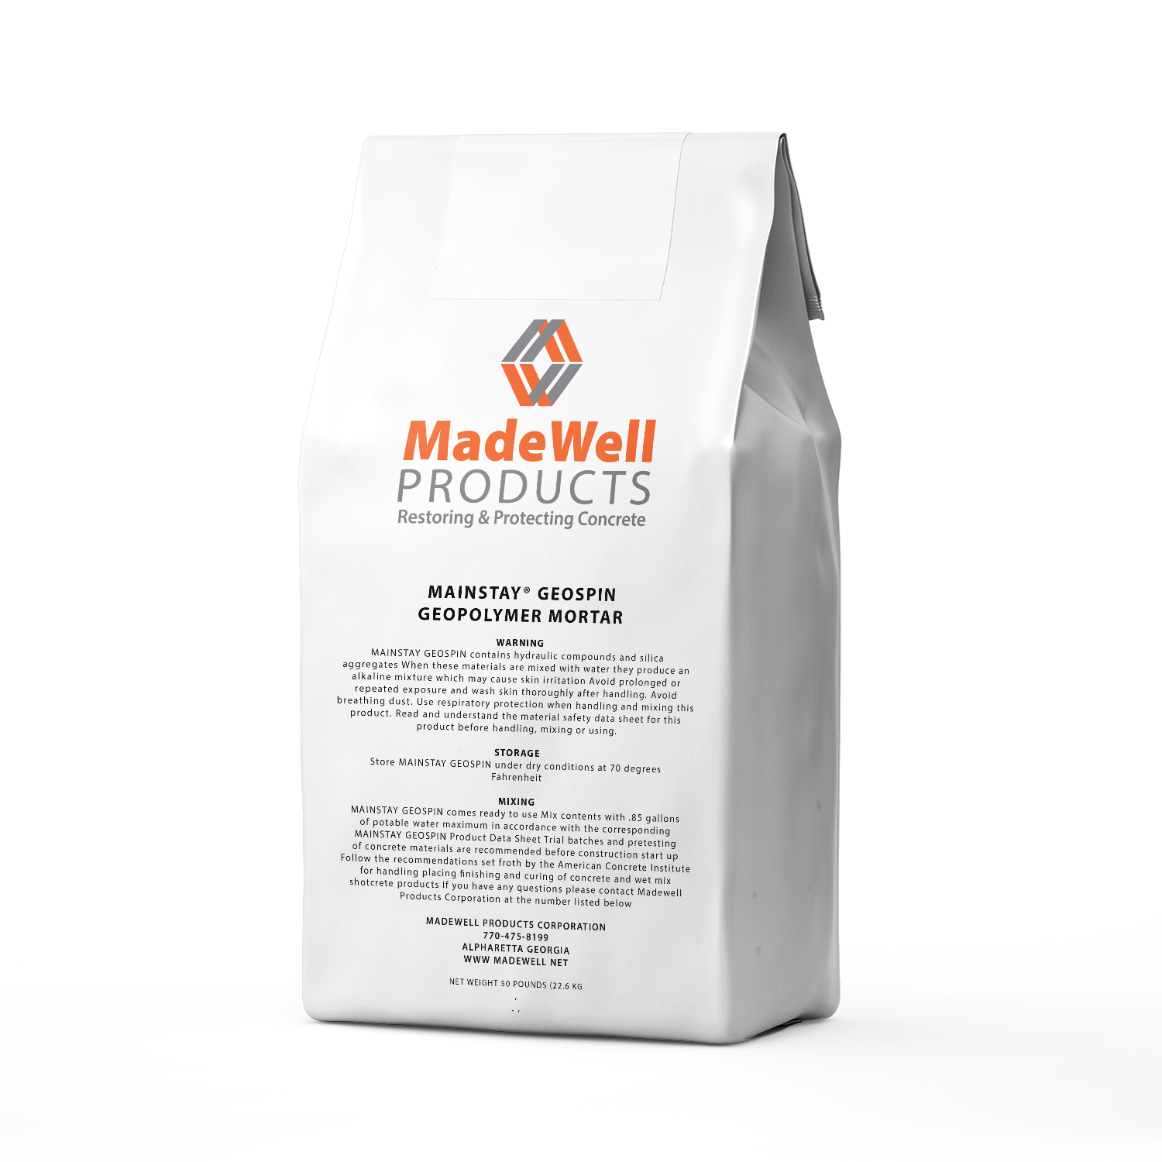
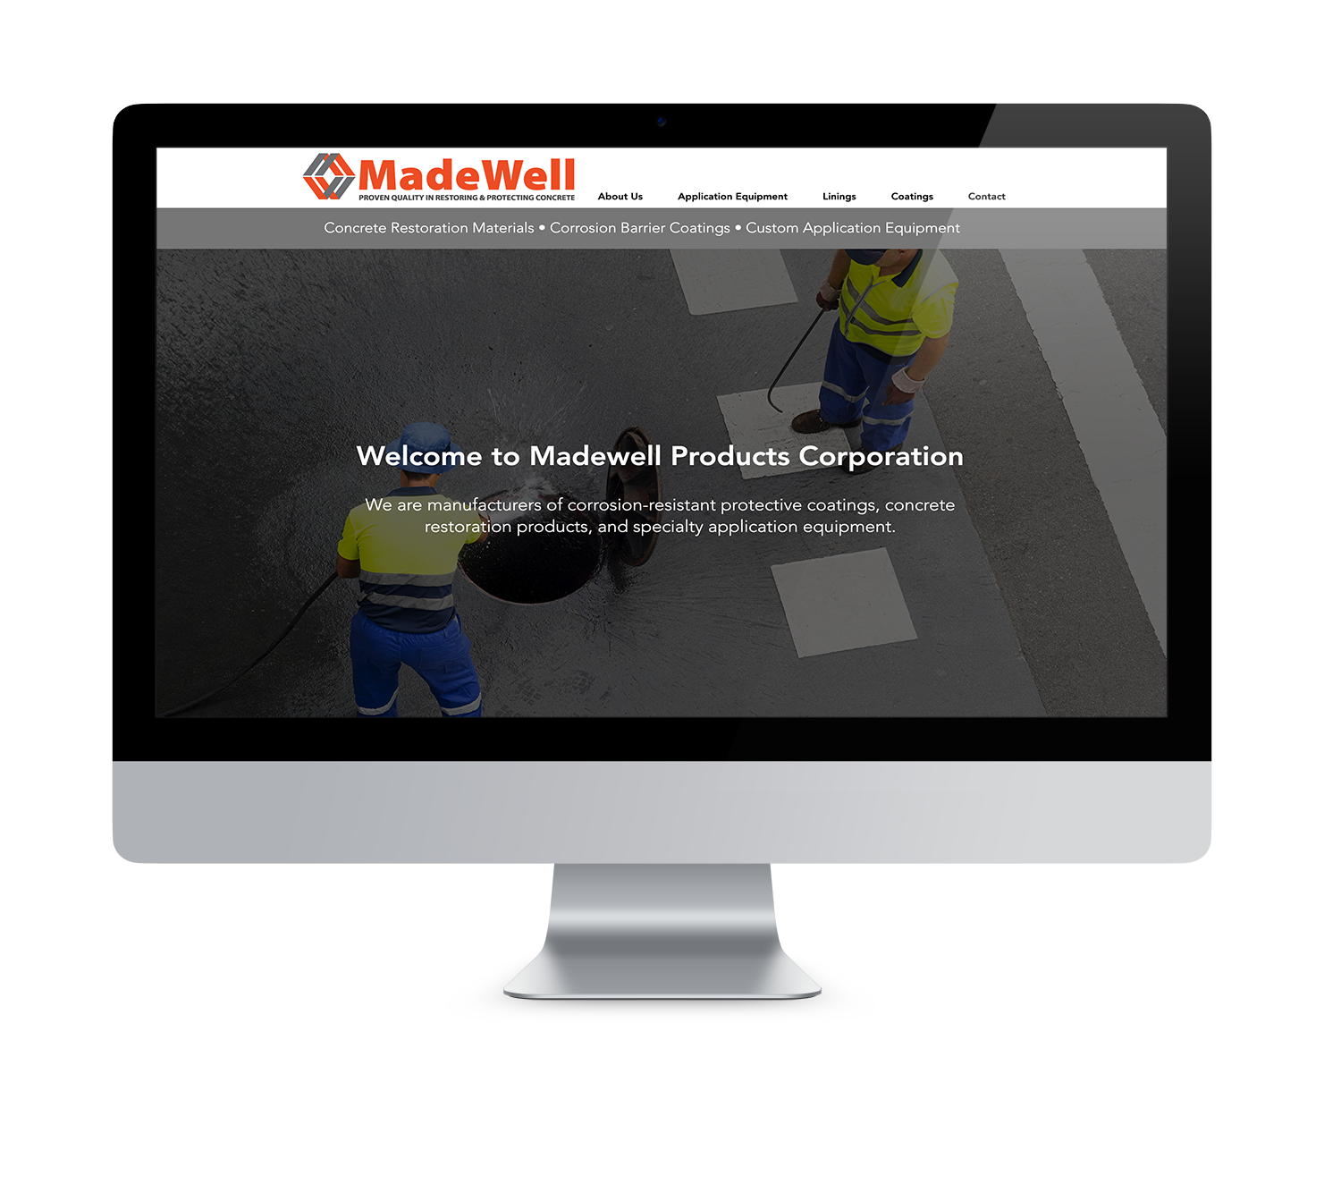
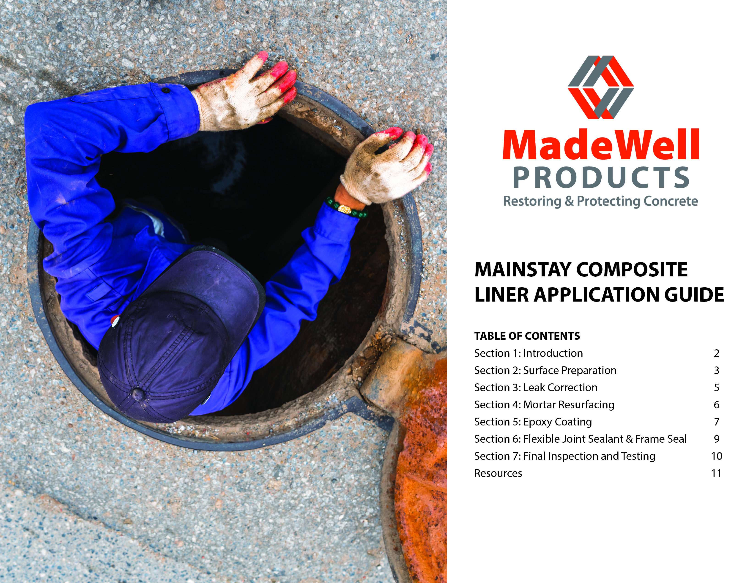
Logo Choices – Choice #1

Slide 6

Logo Choices-Choice #2

Slide 7

Logo Choices-Choice #3

Slide 8



Color Options
1
2
3

Slide 9
Taglines (Current) The Name Says It All
Mainstay Products for Restoring & Protecting Concrete
Proven Quality in Restoring & Protecting Concrete
Family Owned and Operated for over 50 years
Restoring & Protecting Concrete

Slide 10
Thank you for your time.

