Slide 1



Powerful Tools for Caregivers

Slide 2
Discover this Powerful New Breakthrough for Caregivers

Slide 3

Better Quality of Life for Caregivers & Clients
Incredible Results!
(this changes everything)

Slide 4


PROBLEM
Stress is a problem for caregivers and they need tools to improve care and quality of life.
Demand for caregivers is rising fast. How can we leverage technology to increase our capabilities with less work and stress?

Slide 5

Solution
A voice driven digital assistant that expands professional, in-home care coverage to 24/7 with less work & stress:
MORNING CHECK-IN
in 30 seconds
VOICE MESSAGING
simple & easy
24/7 CALL FOR HELP
to our urgent response center

Slide 6


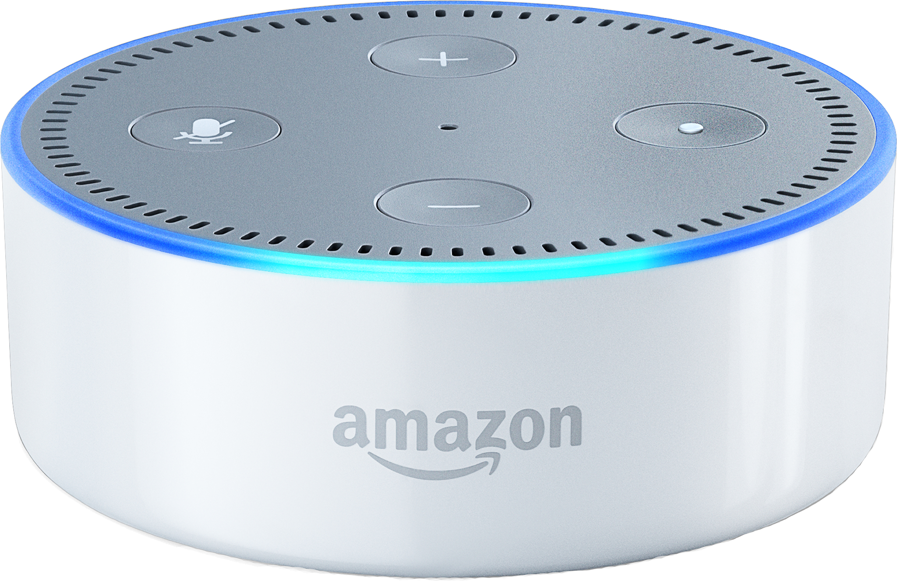

Introducing
Companion - Call for Help
Works with Amazon Alexa

Slide 7

What would a 7.5% revenue increase
with no additional equipment or labor cost
do for your bottom line?

Slide 8
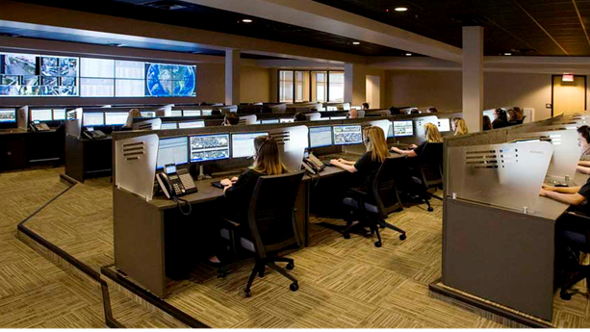
Urgent Response | 24/7
Back-up for Caregivers:
Our highly trained urgent response agents are always & on your team.
Expand Your Care:
From part-time coverage to a 24/7 solution. Increase customer retention.

Slide 9


Each Amazon Echo
Covers 1,000 sq. ft.
Multiple Units Whole House
Coverage
*Wi-Fi
Required

Slide 10
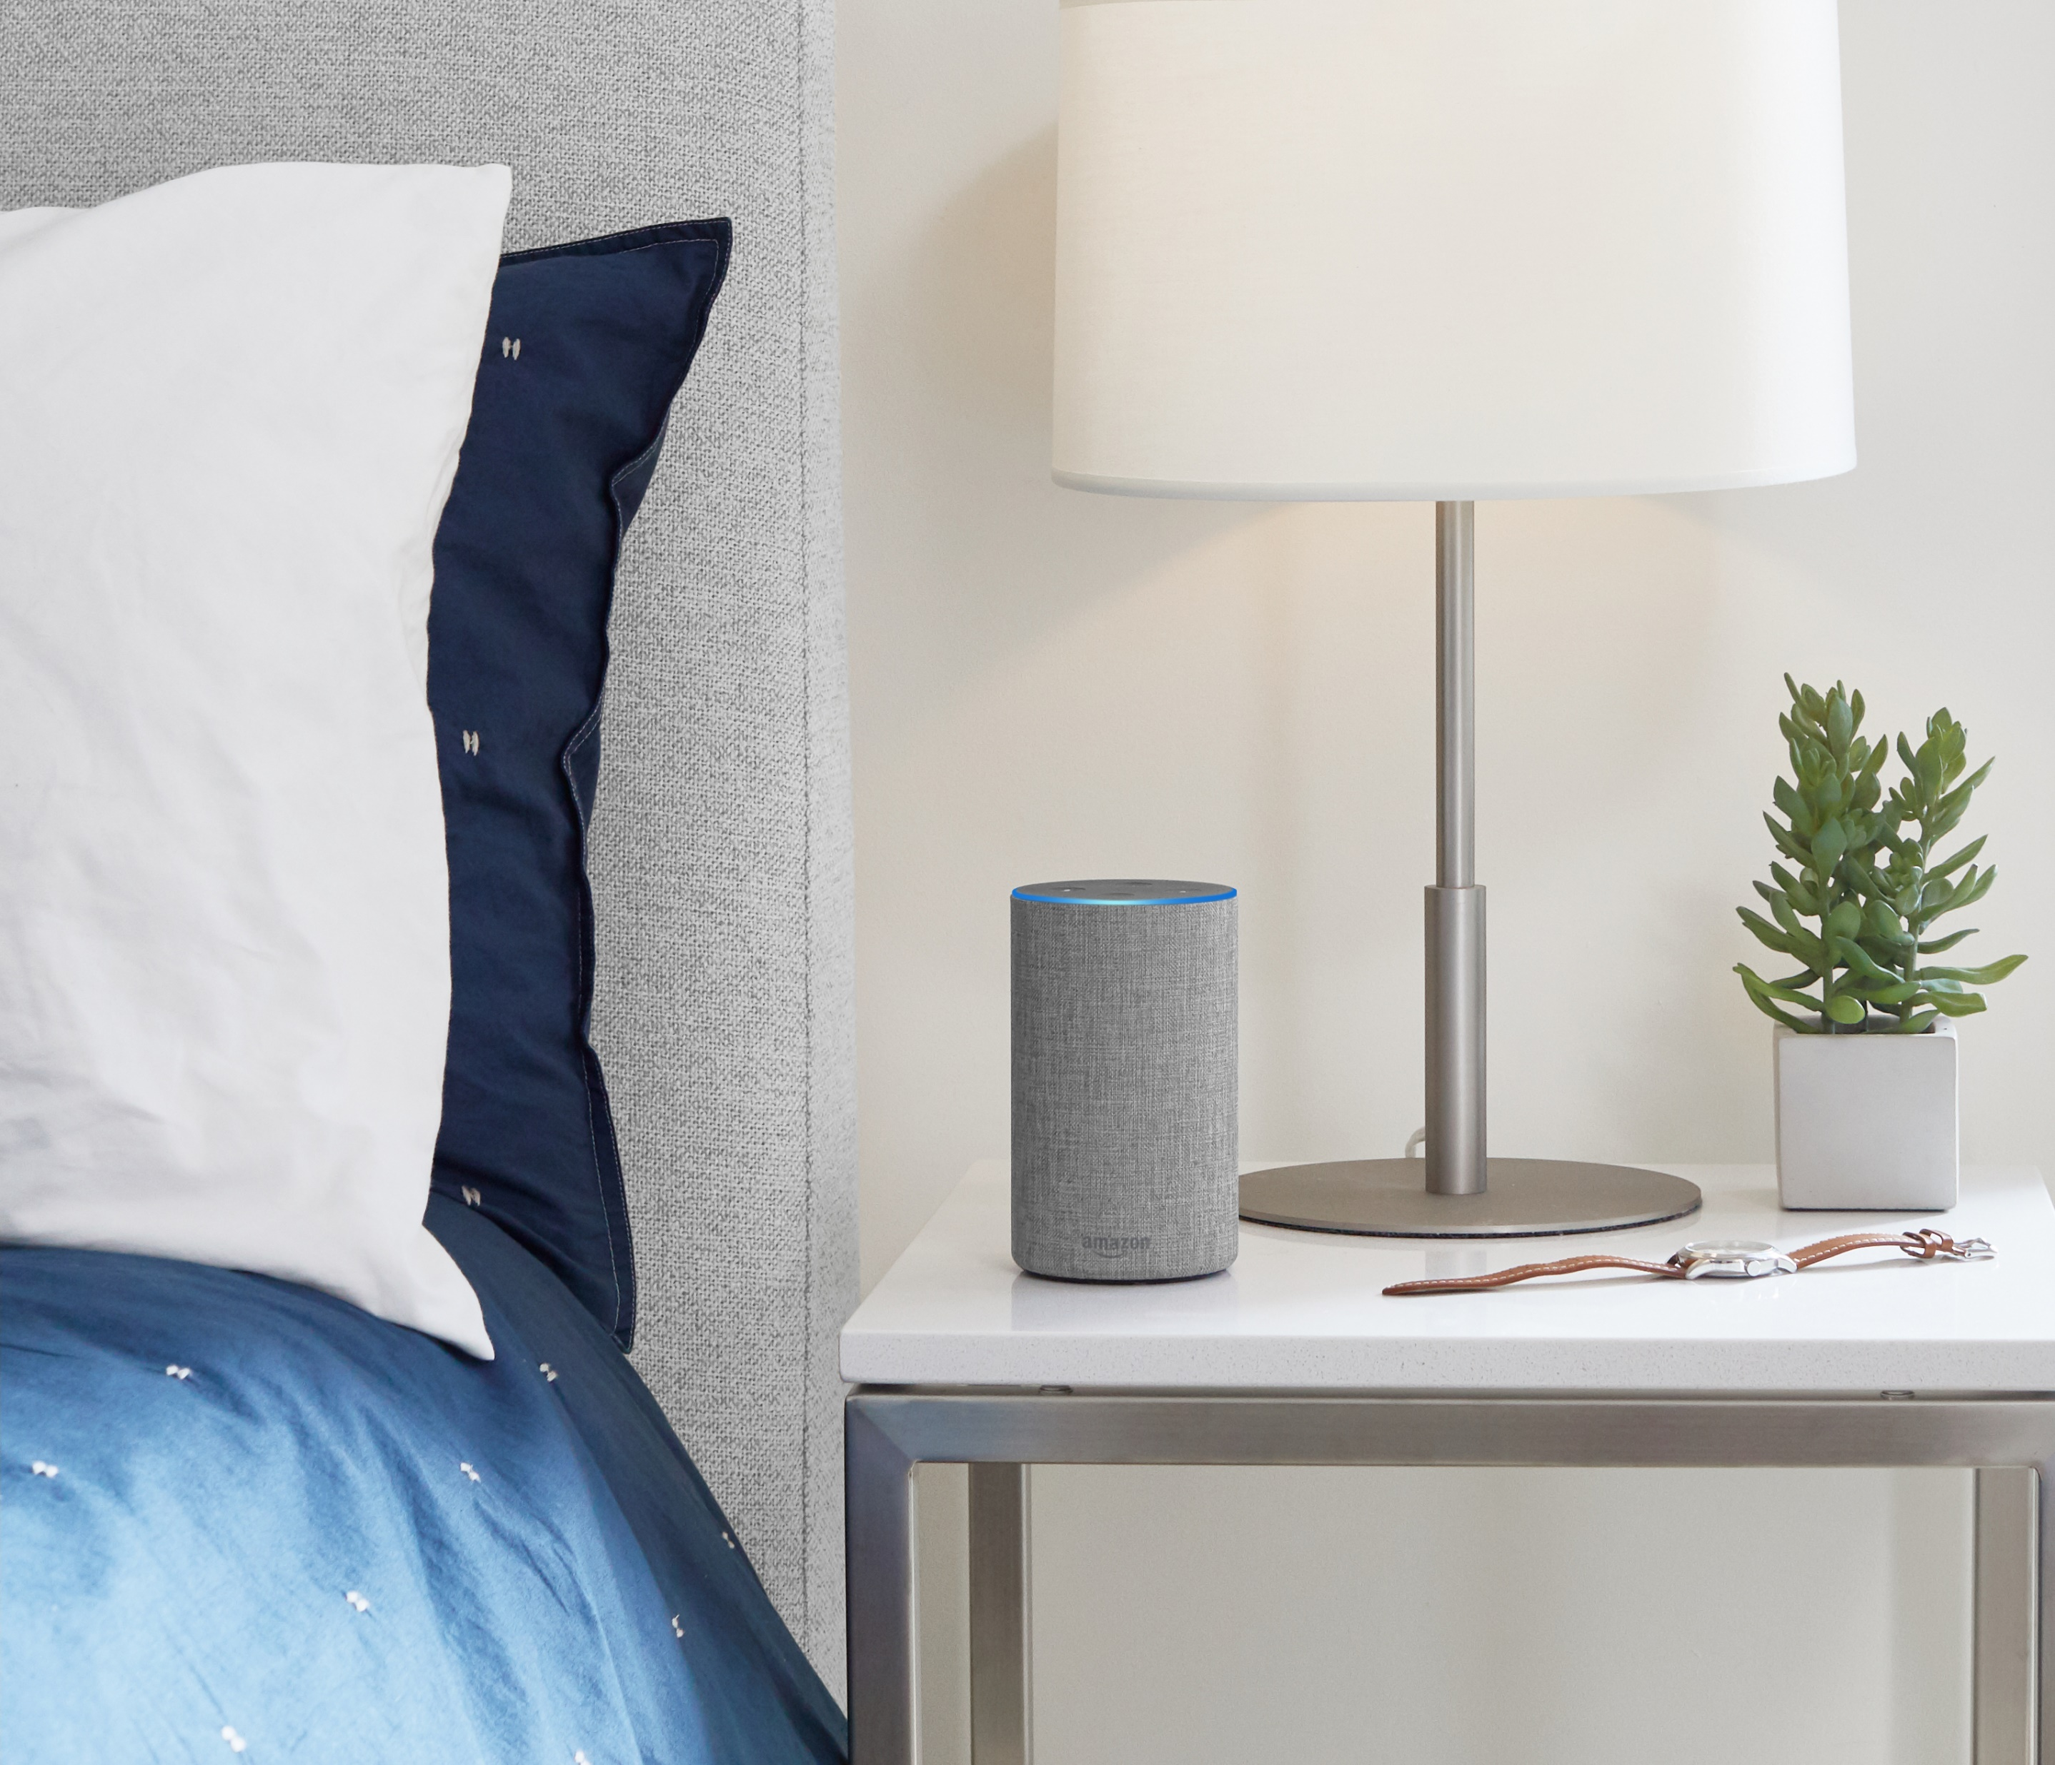
Getting Started
Nothing to Lose
No long term agreements. Cancel anytime.
Simple & Easy
We provide all the equipment, installation, training & support.

Slide 11



Slide 12
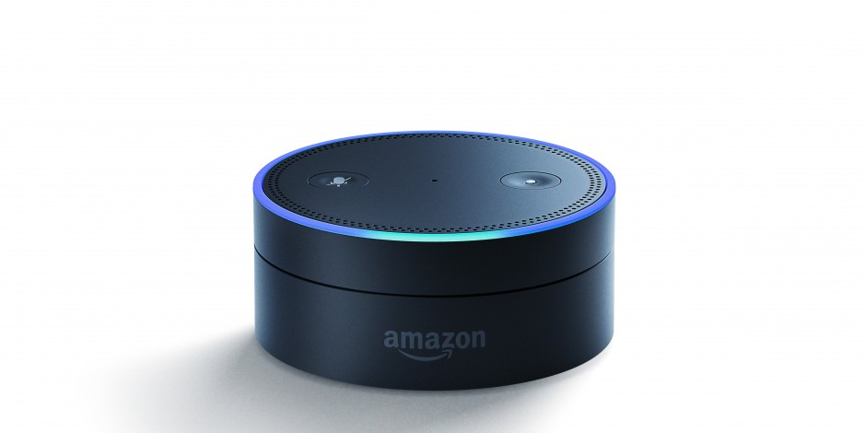
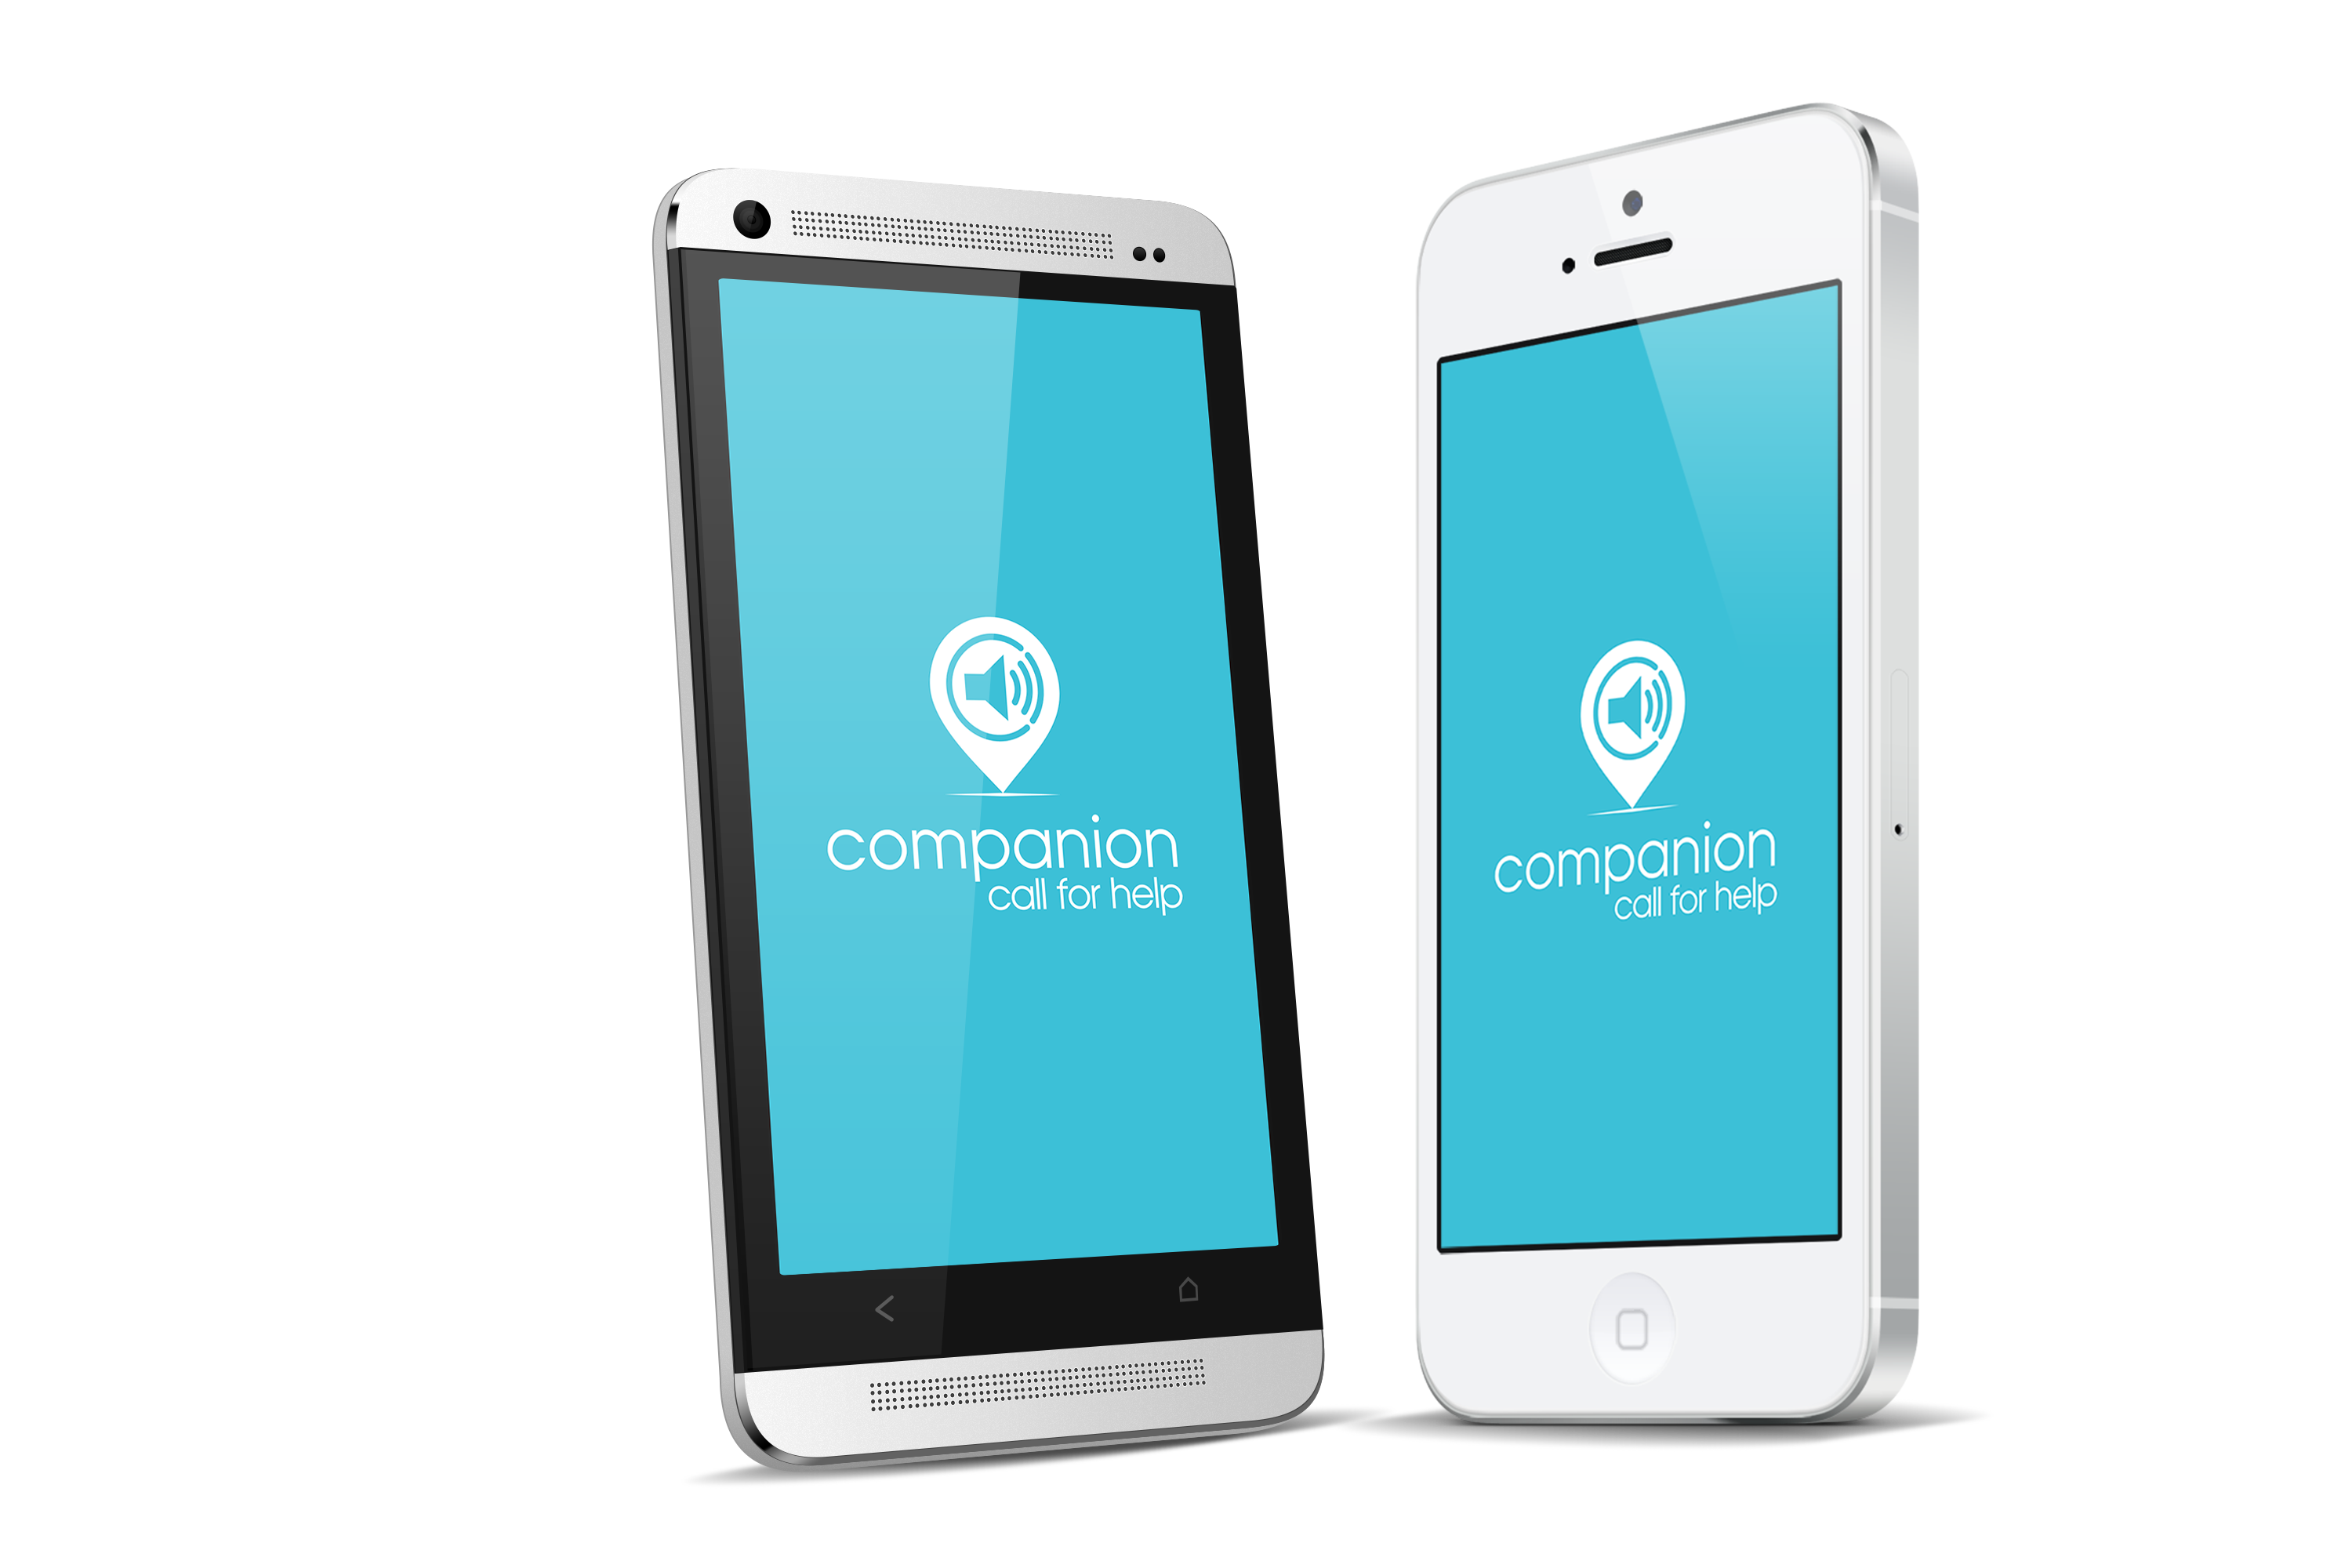
Simple
Find out how simple & easy it is to get started with voice technology. We make it easy.

Slide 13

Mark Gray: 941.264.6888
Email: mgray@wayssecurity.com
Address: 863 Commerce Blvd North, Sarasota, FL 34243
Website: www.CompanionHelp.com

